Slide 1

Centre for Development of Advanced Computing (C-DAC), Chennai
A PROJECT ON
“CREDIT CARD FRAUD DETECTION”
Submitted In Partial Fulfillment Of The Requirement For The Course Of Diploma In Big Data Analysis
SUBMITTED BY :
Maneesh Devasani
PRN :220360825013
Gauri Naphade
PRN :220360825015
UNDER THE GUIDANCE OF :
Mr. K K Dhanesh
CDAC Chennai

Slide 2
Problem Definition
In the banking industry, credit card fraud detection using machine learning is not only a trend but a necessity for them to put proactive monitoring and fraud prevention mechanisms in place.
Machine learning is helping these institutions to reduce time-consuming manual reviews, costly chargebacks and fees as well as denials of legitimate transactions.
In this project we will detect fraudulent credit card transactions with the help of Machine learning models. We will analyse customer-level data that has been collected and analysed during a research collaboration of Worldline and the Machine Learning Group.

Slide 3
PRoJECT Objective
Objective of this project is to create a complete system to detect and recognize the fraudulent transaction by using Machine Learning models.
One downside that has been witnessed over the past few years of this increasing digital phenomenon is the rise of fraud on the credit card.

Slide 4
PLATFORM
PYTHON : Programming Language.
JUPYTER NOTEBOOK : To write, execute and visualize the code.
LIBRARIES :
Numpy & Pandas : For performing data analysis.
Matplotlib.pyplot : For plotting the required graphs.
Sklearn : For model building.

Slide 5
MODULES AND MODULEWISE TASKS
Loading the dataset
Reading the dataset
Performing Exploratory data Analysis
Splitting the data into Train and Test data
Model Building using Machine Learning Algorithms
Confusion Matrix
Logistic Regression with L1 and L2 Regularization
KNN (K-Nearest Neighbor)
Decision Tree Classifier
Random Forest
XGBoost
SVM (Support Vector Machines)

Slide 6
LOGISTIC REGRESSION
Created a common function to fit and predict on a Logistic Regression model for both L1 and L2
Found predicted values and Probabilities.
Accuracy of L1 and L2 models.
Confusion Matrix for L1 and L2 models.
Classification Report which have the values of precision, recall and F1-score
Plotting ROC and Threshold values by using graph and getting percentage of it.
Total time taken by the Model.

Slide 7
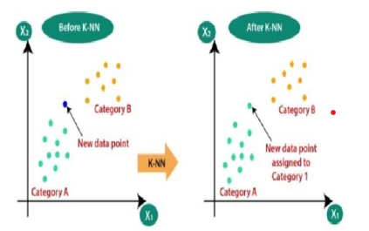
KNN (K-NEAREST NEIGHBOR)
Created a common function to fit and predict on a KNN model.
Created KNN model and fit the model with train dataset.
Calculated Accuracy.
Calculated roc auc.

Slide 8
DECISION TREE CLASSIFIER
Created a common function to fit and predict on a Tree models for both gini and entropy criteria.
Evaluated Decision Tree model with 'gini' & 'entropy’
Gini score Confusion Matrix Classification report ROC for test dataset.
Entropy score Confusion Matrix Classification report ROC for test dataset.

Slide 9
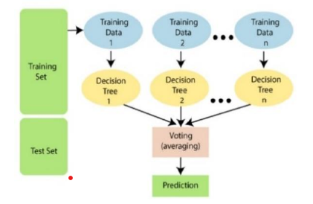
RANDOM FOREST
Created a common function to fit and predict on a Random Forest model.
Evaluate Random Forest model.
Create the model with 100 trees.
Fit on training data.
Actual class predictions.
Probabilities for each class.
Calculate roc auc.

Slide 10
XGBOOST
Created a common function to fit and predict on a XGBoost model.
Evaluate XGboost model.
Calculating Model Accuracy.
Plotting Confusion Matrix.
Calculating Probabilities for each class.
Calculate roc auc.
Calculating XGBoost threshold.
Calculating ROC for the test dataset.

Slide 11
SVM (SUPPORT VECTOR MACHINES)
Created a common function to fit and predict on a SVM model.
Evaluate SVM model with sigmoid kernel model.
Calculating Model Accuracy.
Plotting Confusion Matrix.
Run classifier.
Calculate roc auc.
Calculate SVM threshold.
Calculate ROC for the test dataset.

Slide 12
PERFORMING CROSS VALIDATION WITH REPEATEDKFOLD
Performed RepeatedKFold and check the results.
Run Logistic Regression with L1 And L2 Regularisation.
Run KNN Model.
Run Decision Tree Models with 'gini' & 'entropy' criteria.
Run Random Forest Model.
Run XGBoost Model.
Run SVM Model with Sigmoid Kernel.

Slide 13
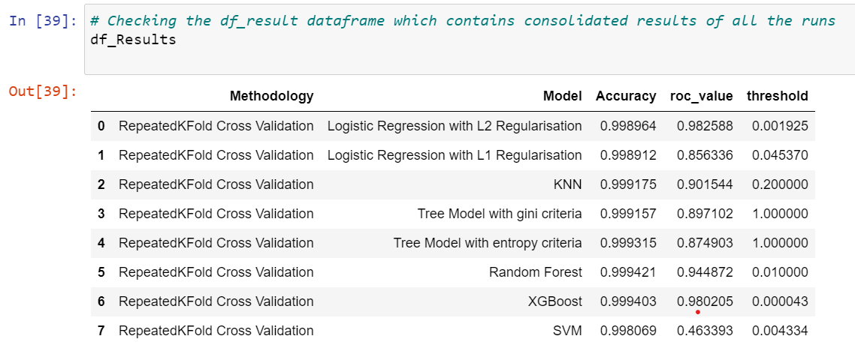
ReSULT
Looking at Accuracy and ROC value we have "Logistic Regression with L2 Regularisation" which has provided best results for cross validation with RepeatedKFold technique.

Slide 14
PERFORMING CROSS VALIDATION WITH REPEATEDKFOLD
Performed StratifiedKFold and check the results.
Run Logistic Regression with L1 And L2 Regularisation.
Run KNN Model.
Run Decision Tree Models with 'gini' & 'entropy' criteria.
Run Random Forest Model.
Run XGBoost Model.
Run SVM Model with Sigmoid Kernel.

Slide 15
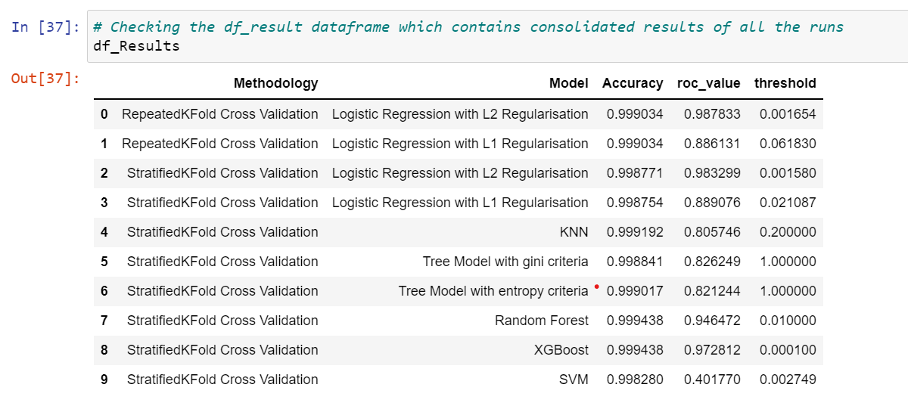
RESULT
Looking at the ROC value we have Logistic Regression with L2 Regularisation has provided best results for cross validation with StratifiedKFold technique.

Slide 16
Conclusion
However, of all the models we created we found Logistic Regression with L2 Regularisation for StratifiedKFold cross validation (without any oversampling or undersampling) gave us the best result.

Slide 17
THANKYOU

